Slide 1
Agile Inception Deck
Notes:
This is your chance to call out any craziness you’ve heard while building the deck, and having a frank conversation with your sponsors and your team about how you are going to handle it.
This is perhaps on of the most powerful slides in the deck – it’s your chance to ask for whatever you need to be successful and the consequences if you don’t get it.
Use it!

Slide 2
Virtual Stock Trader
Sponsors: Titi, Sandil, Gormley, Joe Corr
Notes:
This is your chance to call out any craziness you’ve heard while building the deck, and having a frank conversation with your sponsors and your team about how you are going to handle it.
This is perhaps on of the most powerful slides in the deck – it’s your chance to ask for whatever you need to be successful and the consequences if you don’t get it.
Use it!

Slide 3


Why are we here?
Give new investors the chance to learn how the stock market works?
Teach new investors about how the stock market can be used?
Make sure that investors know what they are doing?
Teach new stock market investors #1
Notes:
Write down all the reasons why your company would want to spend money on this project in the first place.
Then pick and highlight the most important one.

Slide 4
The Elevator Pitch
For [new investors]
who [need a safe way of exploring the functions of the stock market]
the [Virtual Stock Trader]
is [a mobile phone application]
that [allows inexperienced users to learn the basics of the stock market without risks to their finances].
Unlike [ETORO and similar companies]
our product [allows users to simulate stocks without risking their hard-earned money in the process].

Slide 5
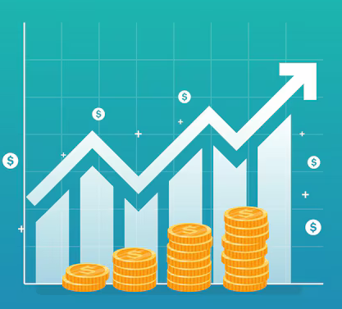

Product Box
Virtual Stock Trader
Trade Safe and Easy
Instant access straight from your phone.
Virtual stocks, no risk involved
Training ground for new investors
Notes:
If you could walk into a store, and buy the shrink wrapped version of your software, what the design of the box look like and what would it say?
Point here is to get your team looking at your project through the eyes of your end customer.

Slide 6
The NOT list
IN | OUT
Live display of currency/stocks prices over a period of time | Random Tips
Search for different & specific stock | View other users’ performance
View & compare trades to the price of a standard currency | Leaderboard of users’ trading success
 | View your statistics & graphs of trading history
UNRESOLVED
Verifying & Signing in through user email
Notes:
List all the big ticket items you are (and are NOT) going to deliver within the scope of this project.
Before starting your project move all the UNRESOLVED ones to either IN or OUT.

Slide 7



Our Project Community
Trading Newcomers
The Stock Market
Market Traders
Notes:
List everyone you are going to have to interact with at some point during the course of your project.
Goal is to start building relationships with these people and let them know we are coming down the tracks (before we actually get there).

Slide 8


Technical solution
NASDAQ/ Fiscal.ai
Java/ JavaScript
React.js
+ DS
Scraps data live from available APIs
Visualises data for the user to interact with
Technologies:
Frontend:
React.js + DS
Java/JavaScript API Implementation
Backend:
Fiscal.ai
NASDAQ (libraries/live info)
Notes:
This is about letting people know how we plan on building this thing.
If there are any tools or libraries assumptions you are making list them here.
Also if there are areas of the application architecture that are risky highlight those too.

Slide 9
What keeps us up at night
Data Collection
Finding free and available APIs
Cost
Paying for APIs if free ones aren’t available
Inaccurately predicting trades
Giving a false idea of how the market works
Notes:
This is your chance to call out any craziness you’ve heard while building the deck, and having a frank conversation with your sponsors and your team about how you are going to handle it.
This is perhaps on of the most powerful slides in the deck – it’s your chance to ask for whatever you need to be successful and the consequences if you don’t get it.
Use it!

Slide 10
The A-Team
# | Role | Competencies/Expectations
1 | DevOps | Familiar with data scrapping Familiar with data visualisation
2 | Developers | jQuery, SQL, JavaScript, Java Unit testing, refactoring, continuous integration UX Design
Notes:
Set expectations around who you are going to need and what kind of skills they will need to have to pull this off.
Use names if specific people are important (i.e. Billy is the only guy who can do X).

Slide 11
How big is this thing?
Release
Approx. 1 week
Testing
Approx. 2-3 weeks
Development
Approx. 10-12 Weeks
Notes:
Give your sponsors some idea of how big this thing is (1, 3, or 6 monther).
Before you can complete this slide you and the team should create and estimate a high-level story list for the project.
This isn’t a commitment (too many unknowns). It’s just a really rough guess. Don’t treat it as anything else.

Slide 12
First Release
Stability
Users have learnt and are comfortable
Bumps & Issues
Users adjusting to the app
Release
Excitement, users learning
Notes:
Give your sponsors some idea of how big this thing is (1, 3, or 6 monther).
Before you can complete this slide you and the team should create and estimate a high-level story list for the project.
This isn’t a commitment (too many unknowns). It’s just a really rough guess. Don’t treat it as anything else.

